Slide 1
System Architecture
Siva Gopalan , Sindhuja

Slide 2
Agenda
Introduction
System Architecture Design
Front End (React)
Backend (Go / Node JS)

Slide 3
Agenda
Database (MongoDB)
Deployment and Scalability
Security and Best Practices
Conclusion
Q & A

Slide 4
Introduction
Overview:
Briefly introduce the core technologies: React, Go, MongoDB, and AI.
Modern , Scalable , Dynamic and Cost effective.
Problem Statement:
"Build a real-time e-commerce platform that provides personalized product recommendations and intelligent customer support."

Slide 5
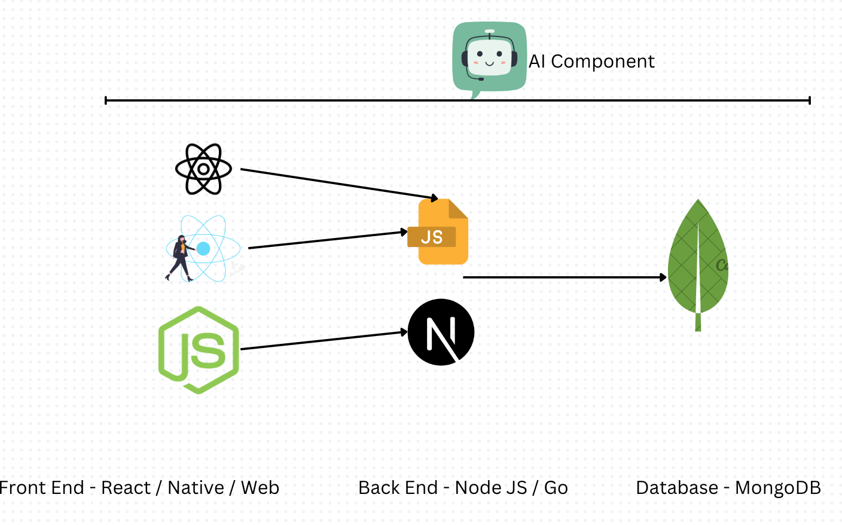
System Architecture Design

Slide 6
Front End (React)
Key Features:
Component-based architecture
Virtual DOM for efficient updates
Rich ecosystem of libraries and tools
Responsibilities:
User interface rendering
Handling user input and events
State management
Routing

Slide 7
Backend (Go lang / Node JS)
Key Features:
High performance and concurrency
Strong typing and static compilation
Easy to learn and use
Responsibilities:
API development
Data processing and validation
Integration with MongoDB
AI model integration

Slide 8
Database (Mongo DB)
Key Features:
Flexible schema
High scalability and performance
Rich query language
Responsibilities:
Data storage and retrieval
User data, product information, and AI model data

Slide 9
AI Component
AI Integration:
Explain how the AI component interacts with the backend and frontend.
Discuss potential use cases, such as:
Recommendation Systems: Personalized product suggestions
Natural Language Processing: Chatbots and sentiment analysis
Machine Learning: Predictive analytics and anomaly detection

Slide 10
AI Component
AI Framework/Library:
Mention the specific AI framework or library used (e.g., TensorFlow, PyTorch, or a cloud-based AI service).

Slide 11
Deployment and Scalability
Deployment Strategies:
Discuss deployment options like containerization (Docker) and cloud platforms (AWS/GCP/Azure).
Scalability Considerations:
Explain how the architecture can scale to handle increased traffic and data.
Mention load balancing, caching, and horizontal scaling techniques.

Slide 12
Security and Best Practices
Security Measures:
Data encryption
Secure authentication and authorization
Input validation and sanitization
Regular security audits
Best Practices:
Code quality and testing
Continuous integration and continuous delivery (CI/CD)
Monitoring and logging

Slide 13
Conclusion
Recap:
Summarize the key points of the presentation.
Future Directions:
Discuss potential future enhancements and integrations.
Q&A:
Open the floor for questions and discussions.

Slide 14
Q & A

